Slide 1
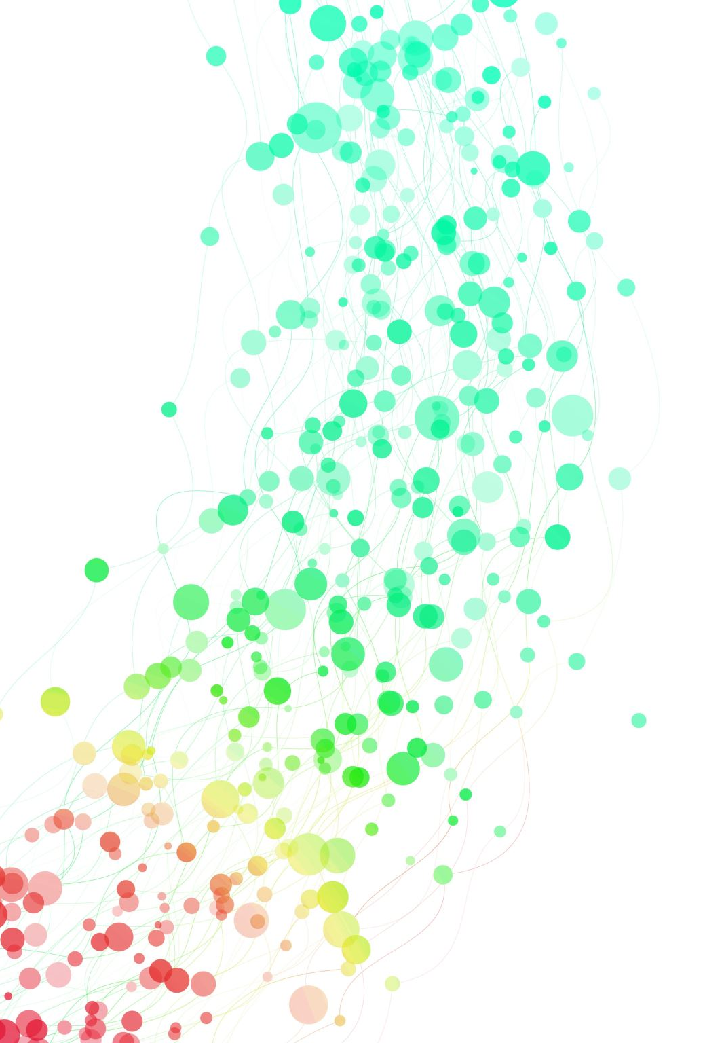
Addressing HR Workforce Challenges

Slide 2
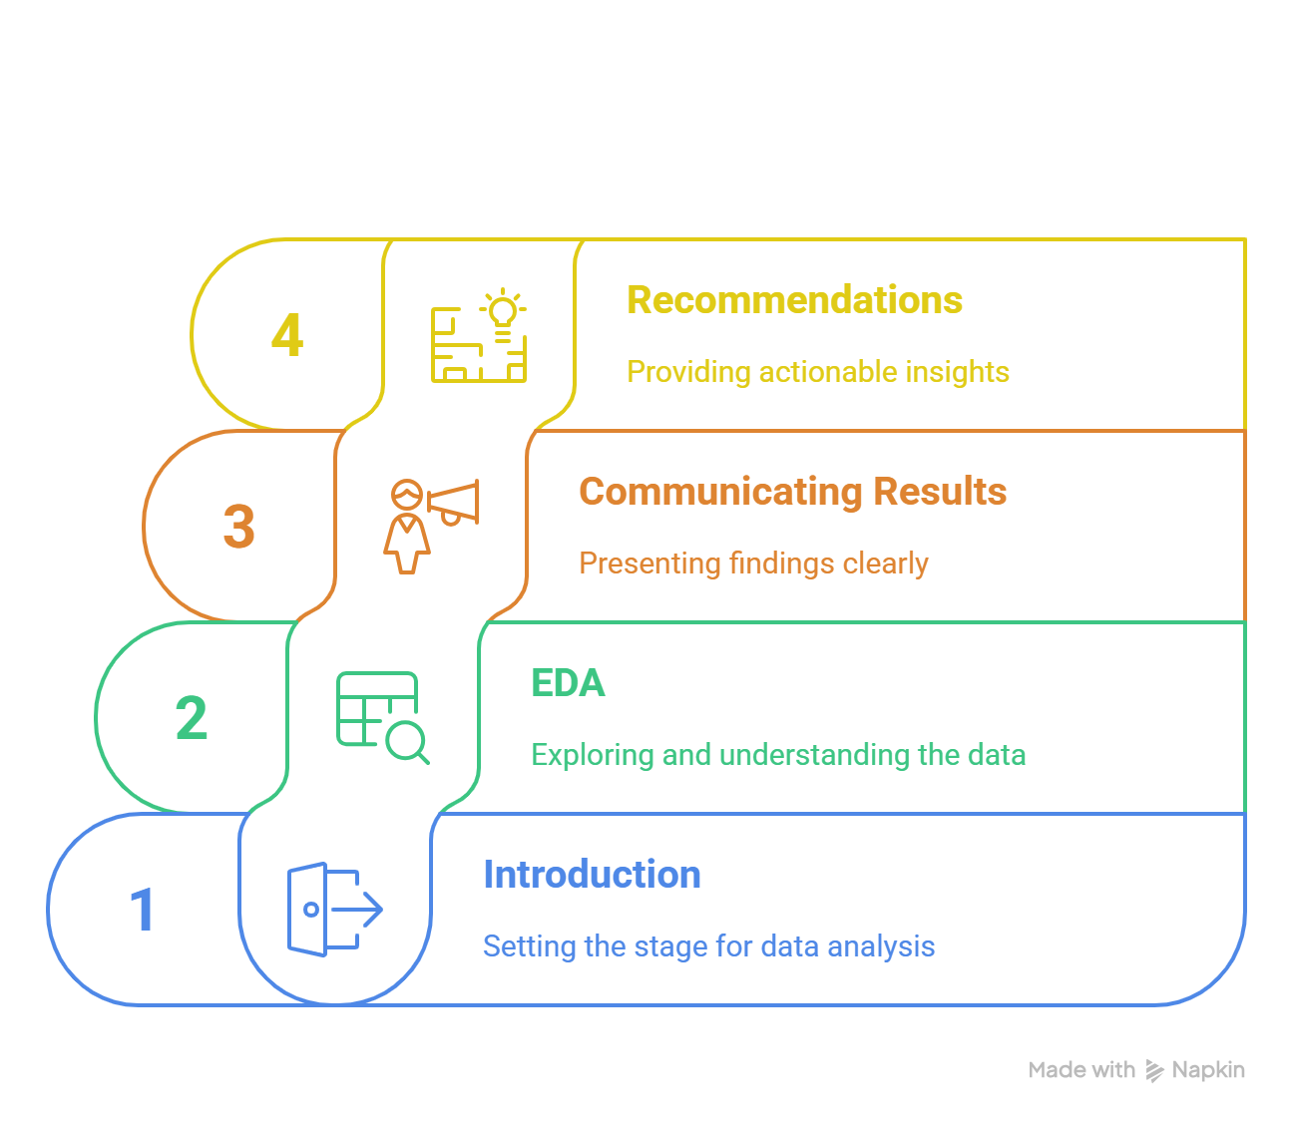
Table of Content

Slide 3
Introduction
During the year 2024, the executive management began to notice worrying indicators:
High employee turnover rates in some locations
Teams suffering from excessive pressure, and others with hardly any tasks
Operational costs are constantly rising without a clear explanation
Difficulty in predicting the efficiency of human resources in new projects
In this analysis, we will try to address those problems and recommend the best course of action to find a better plan to retain employees and reduce workload and improve human resource performance

Slide 4
Exploratory Data Analysis
Data Gathering
The dataset is split across four CSV files. Below are the column names and corresponding table names for each file.
Attendance(Employee ID, Date, Check In, Check Out)
Employees(Employee ID, Position, Department, Country, Date of Joining, Status, Daily Working Hours)
Projects(Project ID, Project Name, Location, Current Headcount, Required Headcount, Start Date, End Date)
Tasks(Employee ID, Project ID, Task Type, Status, Date, Assigned By)

Slide 5
Exploratory Data Analysis
Important KPIs
Average Employee Tenure
Resigned Employees Rate
Active Employees Rate
On-leave Employees Rate
Tasks Completion Rate
Escalated Tasks Rate
Workload Variance Rate

Slide 6
Exploratory Data Analysis
Data Cleaning
In the Attendance Table
Created a new column by calculating the difference between check-out and check-in times and call it Actual Working Hours.
Created a new table by grouping by the Employee ID column and calculating the average working hours and last attendance date per employee.
Joined the resulting table with the Employees table using an inner join on Employee ID.

Slide 7
Exploratory Data Analysis
Data Cleaning
In the Employees Table
Created a new column that measures the difference between Last Attendance Date and Date of Joining and call it Employee Tenure (Months).
Created a new calculated column to represent the workload status. It has 3 categories: Balanced, Overloaded, and Underloaded
Created a new calculated column to represent the assignment status (whether an employee is assigned tasks or not).

Slide 8
Exploratory Data Analysis
Data Cleaning
What-if Scenario
Let's see what happens if we adjust the working hours and the number of employees by a specific percentage in relation to the completion rate and workload variance rate?
Assume each new employee will work 8 hours daily.
We created a numeric range parameter from -0.5 to 0.5 to control the change in the working hours called Workload Change % and another parameter to control the percentage change in the number of employees called Number of Employees Change %.
Go to the report for more technical details and calculations

Slide 9
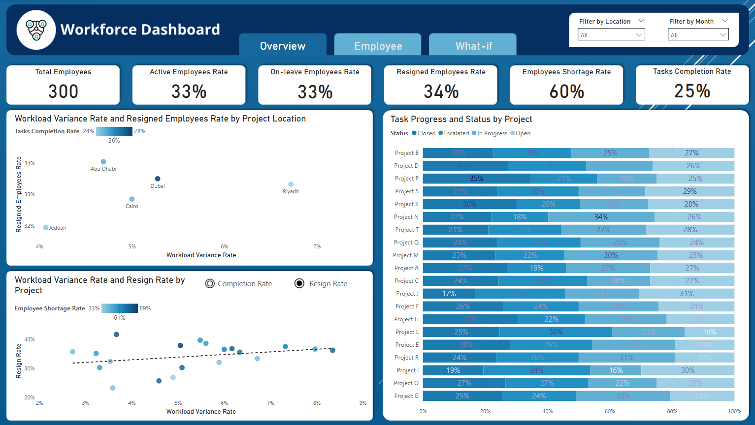
Communicating Results

Slide 11
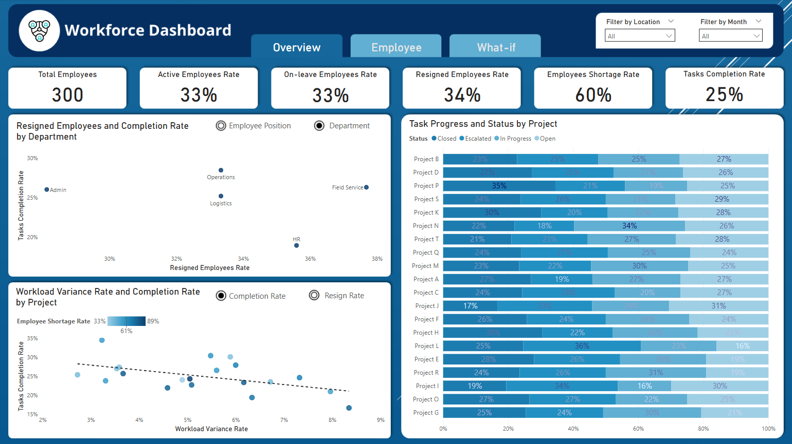
Communicating Results
There are 300 employees in the company.
33% of them are active.
33% of them are on leave.
34% of them have resigned.
The employee shortage rate is 60%, which is significant. I believe the company needs to hire more employees.
The task completion rate stands at 25%.

Slide 12
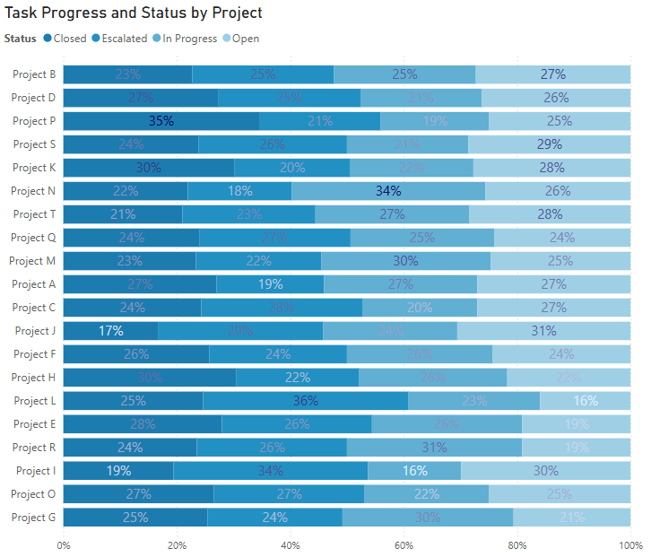
Communicating Results
Here, we can see the task completion percentage, escalated task percentage, open task percentage, and in-progress task percentage for each project.
Project L has the highest percentage of escalated tasks (36%), while Project N has the lowest (18%).
Project P has the highest percentage of completed tasks (35%), whereas Project J has the lowest (17%).

Slide 13
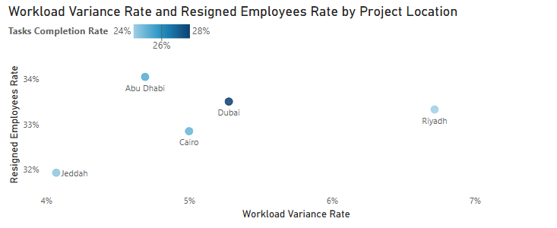
Communicating Results
Projects in Abu Dhabi have the highest resignation rate.
Projects in Riyadh experience the highest workload variance.
Projects in Jeddah have the lowest workload variance and the lowest resignation rate.
Projects in Dubai have the highest completion rate.

Slide 14
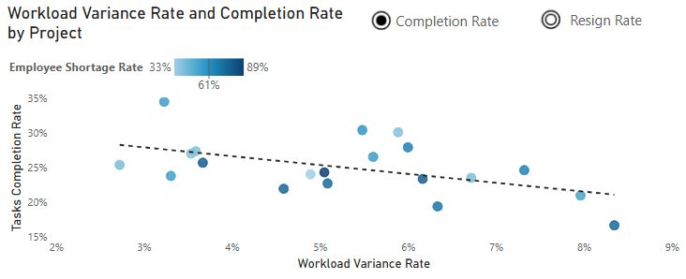
Communicating Results
We can see that projects below the trend line have a high employee shortage rate and a low completion rate.
The relationship between the completion rate and the workload variance rate is negatively correlated. That is, when the workload variance rate is high, the completion rate is low.
Projects that have a high employee shortage rate tend to have more workload variance.

Slide 15
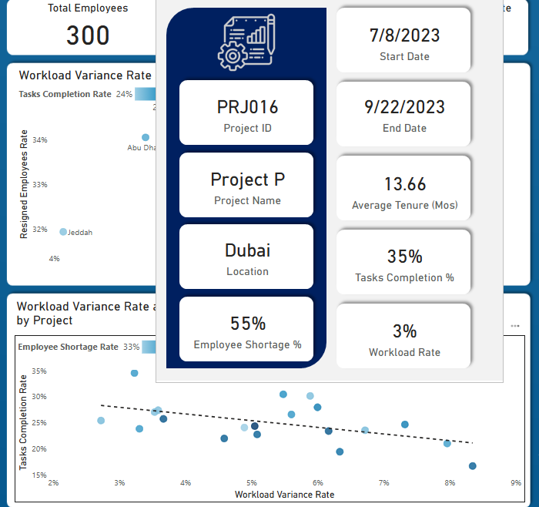
Communicating Results
We can see that projects below the trend line have a high employee shortage rate and a low completion rate.
The relationship between the completion rate and the workload variance rate is negatively correlated. That is, when the workload variance rate is high, the completion rate is low.
Projects that have a high employee shortage rate tend to have more workload variance.
If we hover over one of the bubbles, we get more information about the project. For example, this project is Project P, and it is located in Dubai. It has the highest completion rate of 35% and a low workload of 3%. The average employee tenure is 13.66 months, and the project started on 7/8/2023 and ended on 9/22/2023.

Slide 16
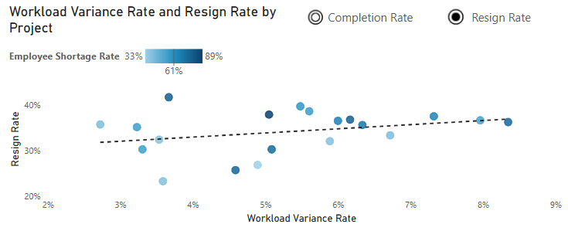
Communicating Results
We can see that projects above the trend line tend to have a higher employee shortage rate than those below the trend line, and hence a higher resignation rate.
Resignation rate and workload variance rate are positively correlated. That is, when the workload variance rate increases, the resignation rate also increases.

Slide 17
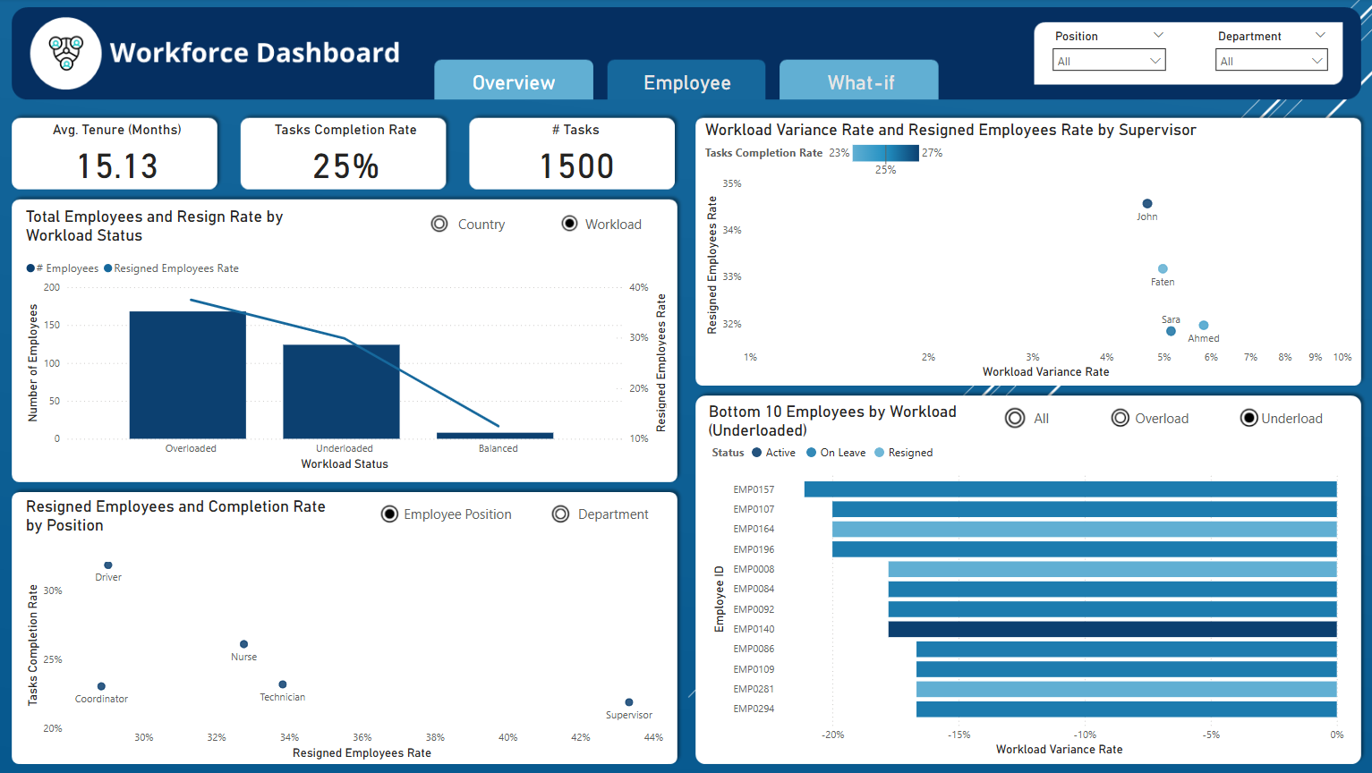

Slide 18
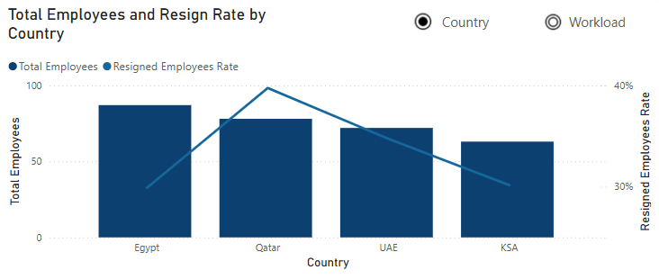
Communicating Results
Most of employees are from Egypt.
Employees who are from Qatar are more likely to resign than employees from other countries.

Slide 19
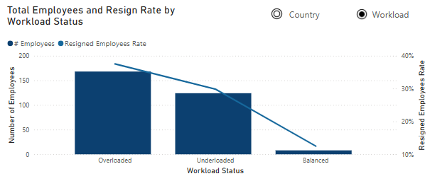
Communicating Results
Here, we can see that more than half of our employees are overloaded, and they are more likely to resign.
A few number of employees work the standard daily working hours.

Slide 20
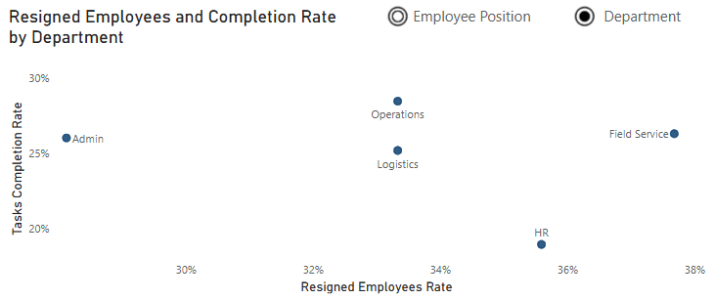
Communicating Results
The Field Service department has the highest resignation rate, whereas the Admin department has the lowest.
The HR department has the lowest task completion rate, whereas the Operations department has the highest.

Slide 21
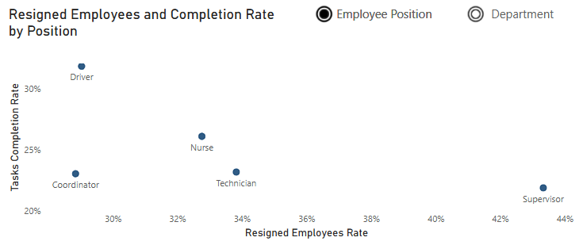
Communicating Results
Supervisors have the highest resignation rate and a low task completion rate, whereas Coordinators have the lowest resignation rate.

Slide 22
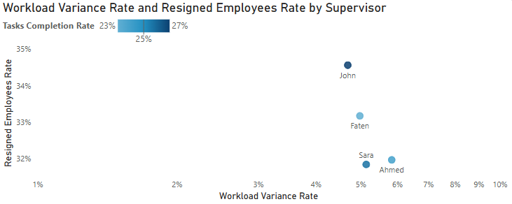
Communicating Results
Employees assigned tasks by John are more likely to resign.
Employees assigned tasks by Ahmed have a higher workload.

Slide 23
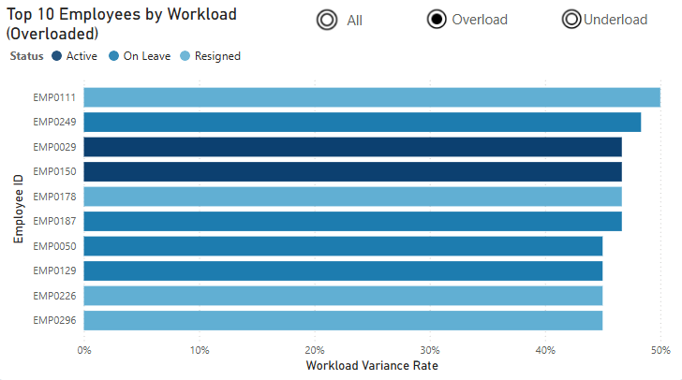
Communicating Results
We can see that there are employees who work more than 40% above the standard daily working hours. They are severely overloaded, and most of them have either resigned or are on leave.
For instance, the employee with ID EMP0111 works 50% more than the standard daily working hours and has resigned.

Slide 24
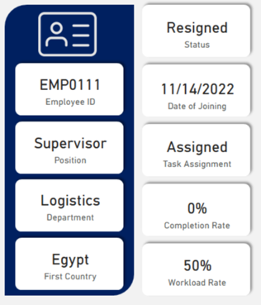
Communicating Results
We can see that there are employees who work more than 40% above the standard daily working hours. They are severely overloaded, and most of them have either resigned or are on leave.
For instance, the employee with ID EMP0111 works 50% more than the standard daily working hours and has resigned.
This employee is a supervisor in the Logistics department and is from Egypt. He joined the company on 11/14/2022. As noted on the overview page, supervisors have the highest workload variance.

Slide 25
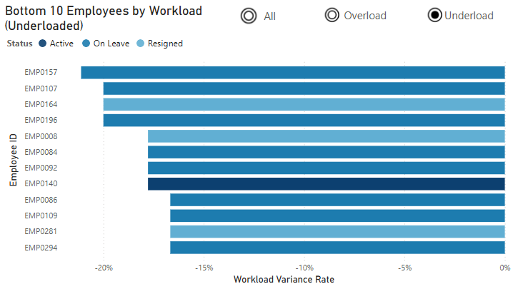
Communicating Results
We can see that there are employees who work 15% or more below the standard daily working hours. Most of these employees are on leave.

Slide 26
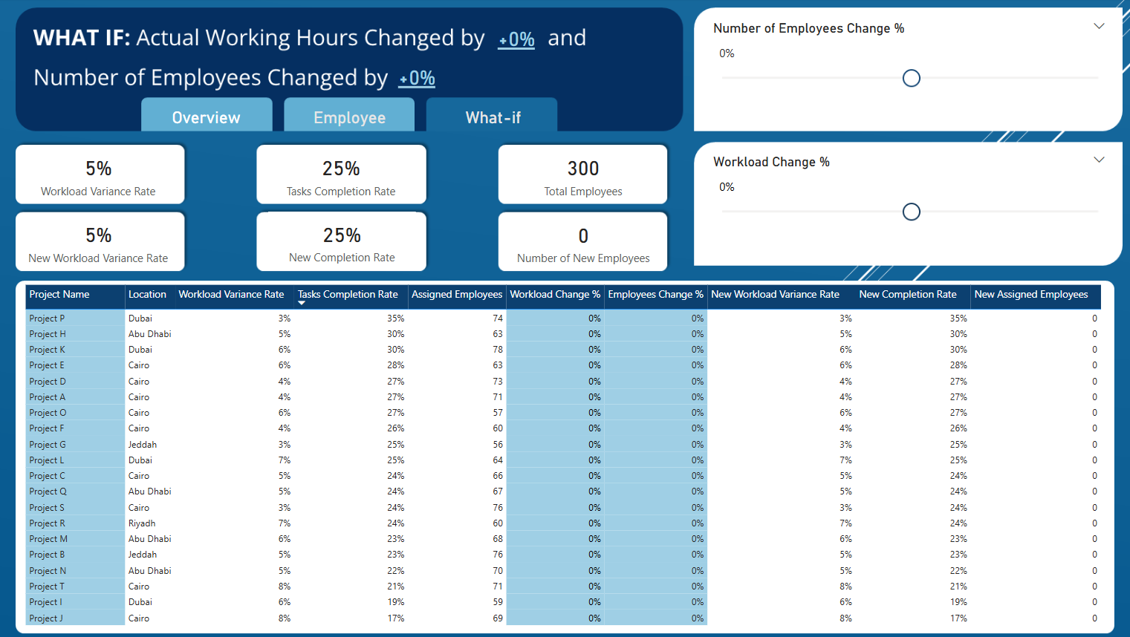

Slide 27
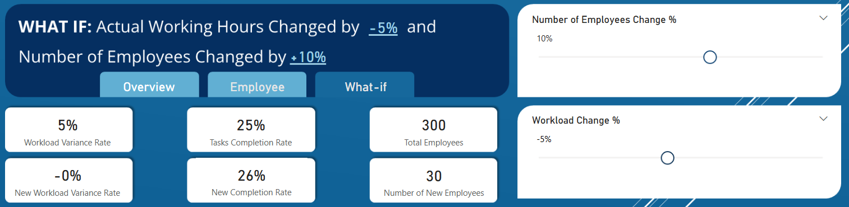
Communicating Results
For example, if we reduce the actual working hours by 5% and increase the number of employees by 10%, we will achieve a 1% increase in the completion rate, and the workload variance rate will be 0%.

Slide 28
Conclusion and recommendations
Workforce challenges require immediate action as they may impact our company's performance and, consequently, its revenue. After analyzing the data, we uncovered several insights that can help the company make informed decisions regarding the hiring process and addressing work overload issues.
The company currently employs 300 individuals, with each employee capable of working on multiple projects. However, only 33% of employees are active, 33% are on leave, and 34% have resigned. This means the majority of employees are not actively contributing. Also, there is a high employee shortage rate of 60%. This shortage has led to significant work overload in certain projects. Supervisors, in particular, are more likely to resign compared to other roles. Additionally, employees in the Field Service department are also more prone to resignation. Most of the employees are from Egypt, and they are less likely to resign. However, employees from Qatar are more likely to resign compared to those from other countries.
Certain projects, such as Project L and Project I, have a high percentage of escalated tasks. Projects located in Abu Dhabi and Dubai have the highest resignation rate, while projects in Riyadh experience the highest workload variance and resignation rate. Furthermore, employees assigned tasks by John are more likely to resign, while those assigned tasks by Ahmed tend to have a higher workload.

Slide 29
Conclusion and recommendations
Recommended Actions:
Conduct Employee Surveys:
Survey employees to identify any issues they face within the company and determine what changes they need.
Focus on employees in Abu Dhabi and Dubai, as these locations have high resignation rates. Additionally, employees from Qatar need more attention as they are more likely to resign.
Include questions to assess whether employees have concerns about their managers, which may help explain why tasks assigned by John result in higher resignation rates.
Reduce Work Overload:
Manage task schedules more effectively to reduce work overload.
Assign employees to specific projects rather than having them work on multiple projects. This will allow us to measure the efficiency of human resources per project and also help reduce work overload.
Hire additional employees to address the high employee shortage rate.
Use the What-If Scenario tool to determine the optimal number of employees and workload distribution that aligns with the company's budget.
Address Escalated Tasks in Project L:
Assign employees to focus on escalated tasks in Project L, as it has a high proportion of unresolved tasks.
Investigate Project J's Low Completion Rate:
Analyze the reasons behind the low task completion rate in Project J.
Determine whether this is due to specific challenges or if it is simply because the project is new.

